Slide 1
«Сұрақ-жауап»
« ВИКТОРИНА »
«БиоАнглийский мир»

Slide 2
Цель:
Активизация и повторение изученных явлений,
лексических единиц и речевых оборотов на материале курса биологии.

Slide 3
«Flora» 11 class
«Fauna» 10 class

Slide 4
I.
I.The fruit of the oak.
A corn
Nut
Coconut

Slide 5
II.A thick forest.
Wood
the heart of the forest
Park

Slide 6
III. You can make eleven and a half omelets from one egg of this bird.
Eagle
Ostrich
Parrot

Slide 7
IV.
It takes 40 minutes to boil this bird’s egg.
owl’s egg
flamingo’s egg
ostrich’s egg

Slide 8
V. It is white with black stripes and not on the contrary.
Tiger
Snake
Zebra

Slide 9
II.
VI.
A forest where oaks grow.
Wood
an oak forest
Park

Slide 10
II.
1 1) CELLS ARE MADE OF ORGANELLES.
2) CELLS ARE MADE OF STONES.
2 1) INSIDE THE VACUOLE THERE IS SOME GEL.
2) INSIDE THE VACUOLE THERE IS SOME SAND.
3 1) IN THE MIDDLE OF THE CELL THE NUCLEUS IS.
2) IN THE MIDDLE OF THE CELL THE MEMBRANE IS.
4 1) THERE ARE THREE TYPES OF CELLS.
2) THERE ARE TWO TYPES OF CELLS.
5 1) RIBOSOMES MAKE VITAMINES.
2) RIBOSOMES MAKE PROTEINS.
6 1) THE MITCHONDRIA GIVES ENERGY.
2) THE MITCHONDRIA GIVES PROTEINS.
7 1) CHLOROPLASTS LOVE SUNLIGHT.
2) CHLOROPLASTS LOVE MOONLIGHT.
8 1) AN ANIMAL CELL HAS A CELL WALL.
2) A PLANT CELL HAS A CELL WALL.

Slide 11
II.
1 1) CELLS ARE MADE OF ORGANELLES.
2) CELLS ARE MADE OF STONES.
2 1) INSIDE THE VACUOLE THERE IS SOME GEL.
2) INSIDE THE VACUOLE THERE IS SOME SAND.
3 1) IN THE MIDDLE OF THE CELL THE NUCLEUS IS.
2) IN THE MIDDLE OF THE CELL THE MEMBRANE IS.
4 1) THERE ARE THREE TYPES OF CELLS.
2) THERE ARE TWO TYPES OF CELLS.
5 1) RIBOSOMES MAKE VITAMINES.
2) RIBOSOMES MAKE PROTEINS.
6 1) THE MITCHONDRIA GIVES ENERGY.
2) THE MITCHONDRIA GIVES PROTEINS.
7 1) CHLOROPLASTS LOVE SUNLIGHT.
2) CHLOROPLASTS LOVE MOONLIGHT.
8 1) AN ANIMAL CELL HAS A CELL WALL.
2) A PLANT CELL HAS A CELL WALL.

Slide 12
III.
1.A tall plant with a thick stem, long leaves and yellow grains concentrated at the top of the plant.
Corn
Sunflower
Tulip

Slide 13
2.A kind of earth at the bottom of the pond/lake/river. Plants grow better on it.
Rocks
Sand
Ooze

Slide 14
3.A plant with red pink or white flowers and round leaves. It can frighten insects.
Geranium
Rose
Sunflower

Slide 15
4.These animals have striped fur and skin.
Tiger
Snake
Zebra

Slide 16
5.A dragonfly can live …. hours.
12
32
24

Slide 17
6.The speed of a snail is about …. per second.
1,5 cm
1,5mm
1,5feet

Slide 18
1.A tree which life is the longest.
Christmas Tree
birch tree
Oak

Slide 19
2.The highest grass in the world.
Banana
Bamboo
Grass

Slide 20
3.A small hard object produced by plants from which a new plant of the same kind grows.
Apple
Seed
Flower

Slide 21
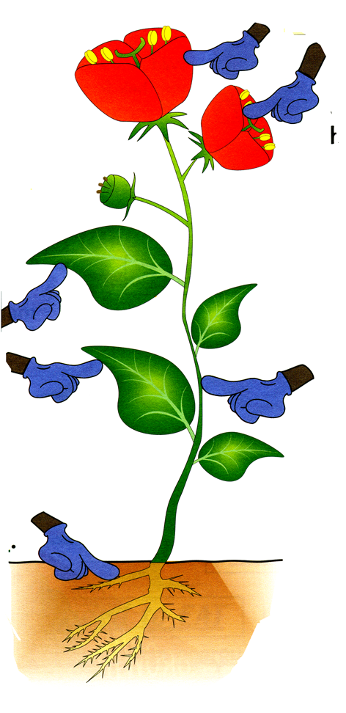
V.
Remember the parts of the flower. Write your answers on the blanks.

Slide 22
Remember the parts of the flower. Write your answers on the blanks.
FLOWERS
PETALS
LEAVES\}
STEM
ROOT

Slide 23
VI.
Физкультминутка
“Skeleton`s dance”

Slide 24
VII.
1.In ancient Egypt the most dangerous animals for the fields were ….
Incets
Hippos
Cats

Slide 25
2.A goldfish can remember any information for …..
3 hours
3 minutes
3 seconds

Slide 26
3.A plant with leaves which are not usual. It grows in hot dry countries.
It can live without water for a long time.
It can have flowers.
Christmas tree
Cactus
camel's-thorn

Slide 27
4.A place where (water)melons are grown.
vegetable garden
Garden
(water)melon plantation

Slide 28
5.A kind of corn that opens when it is heated. It is usually eaten warm with salt or sugar.
pop-rice
pop-corn
pop-potato

Slide 29
6.Mammals give milk to their babies. The only mammal which cannot jump is …..
Giraffe
Hippo
Elephant

Slide 30
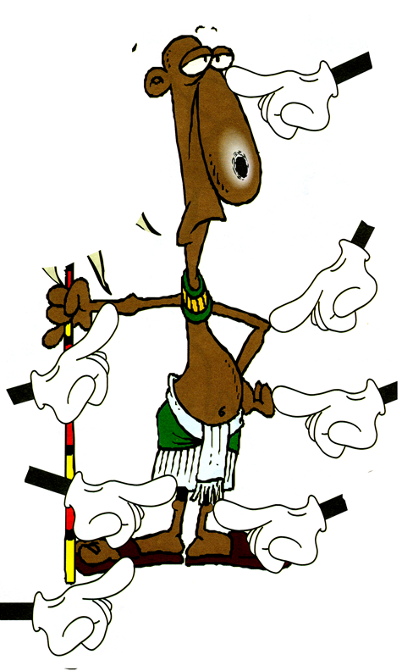
VIII.

Slide 32
IX.
1.The only bird which can swim but cannot fly is …..
Flamingo
Penguin
Ostrich

Slide 33
2.A little plant that grows on the surface of water.
Rose
Tulip
Duckweed

Slide 34
3.Grass that is cut and dried. It is used as food for animals in winter.
Banana
Bamboo
Hay

Slide 35
4.If this animal catches you, push on its eyes with your fingers.
Tiger
Snake
Crocodile

Slide 36
5.These animals sleep with one eye opened.
Elephants
Dolphins
Cows

Slide 37
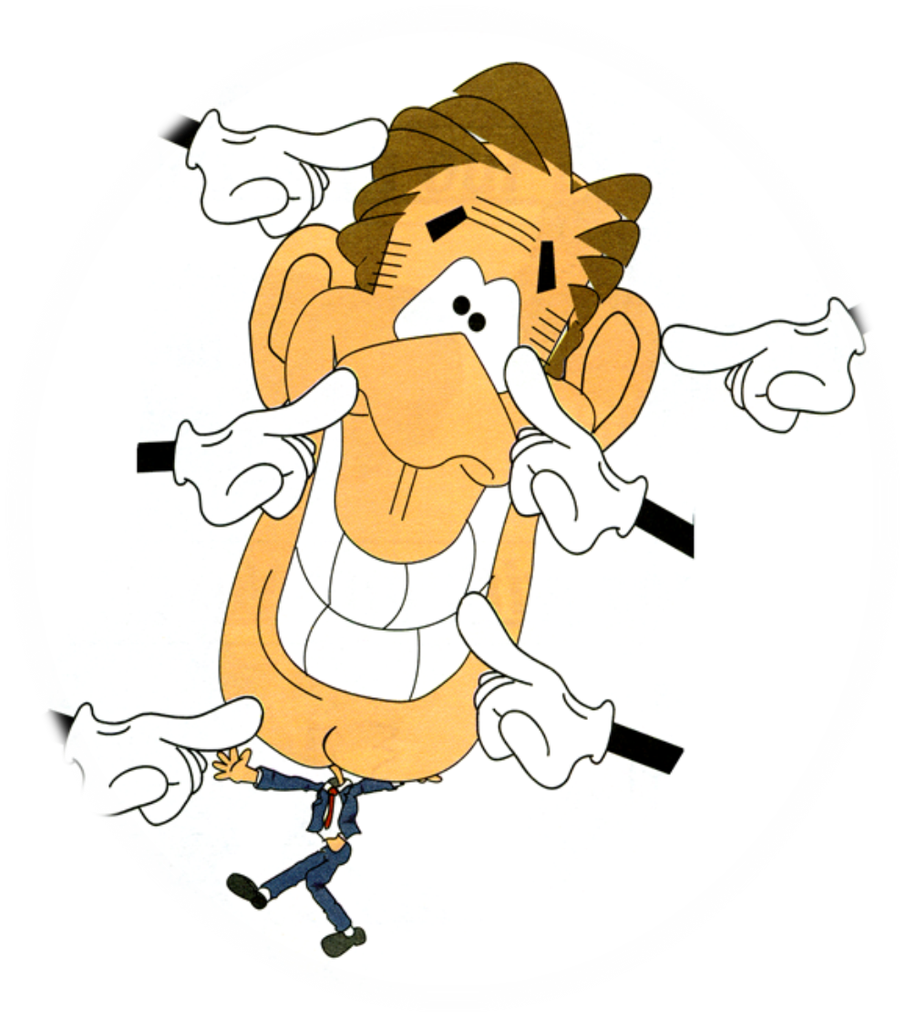
X.

Slide 38
X.
HAIR

Slide 39
XI.
Рефлексия
Our competition is finishing. While the jury is counting points, let’s look at our progress.
If you have answered all the questions today – 3 claps.
If you have answered some questions – 2 claps.
If you have had problems – 1 clap.
Наше соревнование заканчивается.
Пока жюри подводит окончательные итоги, посмотрим на наши успехи.
Если вы ответили на все вопросы – 3 хлопка.
Если вы ответили на часть вопросов – 2 хлопка.
Если практически не ответили – 1 хлопок

